Slide 1
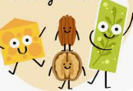
Introduction
Lipids are a heterogeneous group of compounds, including fats, oils, steroids, waxes, and
related compounds, which are related more by their physical than by their chemical properties
They have the common property of being
relatively insoluble in water and soluble in nonpolar solvents such as ether and chloroform
Biological functions include;
Excellent energy reserves
Structure of cell membranes
Organ padding/Protection
Body thermal insulation
Essential fatty acids (EFA)
Hormone synthesis
Fat soluble vitamin absorption

Slide 2
Although metabolism embraces hundreds of different enzyme-catalyzed reactions, our major concern here is the central metabolic pathways,
which are few in number and remarkably similar in all forms of life.
Living organisms can be divided into two large groups according to the chemical form in which they obtain carbon from the environment.
Autotrophs (such as photosynthetic bacteria and vascular plants) can use carbon dioxide from the atmosphere as their sole source of carbon, from which they construct all their carbon-containingbiomolecules

Slide 3
Some autotrophic organisms, such as cyanobacteria, can also use atmospheric nitrogen to generate all their nitrogenous components.
Heterotrophs cannot use atmospheric carbon dioxide and must obtain carbon from their environment in the form of relatively complex organic molecules such as glucose.
Multicellular animals and most microorganisms are heterotrophic.
Autotrophic cells and organisms are relatively self-sufficient,
whereas heterotrophic cells and organisms, with their requirements
for carbon in more complex forms, must subsist on the products of other organisms

Slide 4

Metabolism, the sum of all the chemical transformations taking place in a cell or organism, occurs through a series of enzyme-catalyzed reactions that constitute metabolic pathways.
Each of the consecutive steps in a metabolic pathway brings about a specific, small chemical change, usually the removal, transfer, or addition of a particular atom or functional group.
The precursor is converted into a product through a series of metabolic intermediates called metabolites.
What is metabolism?

Slide 5
Introduction Con’t
Sources of Fatty Acids for Cellular Fuel
Cells can obtain fatty acids from three main sources:
Dietary Fats
Stored Fats
Synthesized Fats
Species Variation
Some species utilize all three sources depending on their metabolic needs
Others may rely on one or two sources based on diet, physiology, or environment

Slide 6
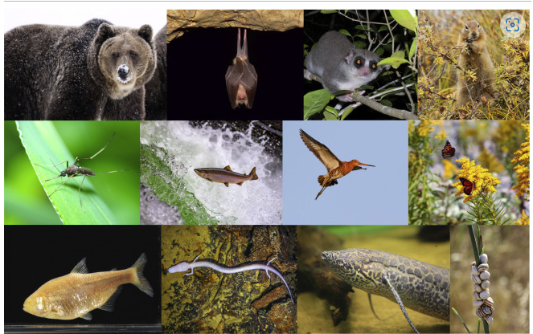
Examples of animals who regularly undergo periods of substantial fat accumulation in preparation for food-scarce conditions
Top left to right: Hibernators: grizzly bear, bats, fat-tailed dwarf lemur, arctic ground squirrel.
Middle left to right: Diapause :mosquito. Migrators: salmon, bar-tailed godwit, monarch butterfly.
Bottom left to right: Cave dwellers: cavefish and the olm. Estivators: lungfish and snails.
The Fat-tailed Dwarf Lemur was photographed by Frank Vassen, distributed under a CC-BY 2.0 license.

Slide 7
Eukaryotic organisms store most metabolic energy in the form of lipids—a long-term energy reserve, with carbohydrates and proteins considered to be short-term energy reserves.
Lipids are energy-dense molecules, with the greatest energy yield per unit of weight, contributing considerably to energy homeostasis, thermoregulation, and membrane fluidity.

Slide 8
Fat-storage locations vary both within and between species,
with most mammals storing fat intra-abdominally (visceral fat) or in the adipose tissue on the periphery (subcutaneous fat).
However, many other species use different locations for lipid storage, such as within feet (amphibians), tails (reptiles), head (whales), and fat body (insects)
While adipose tissue comprises the majority of stored lipids, other organs throughout the body, such as the liver, skeletal muscle, and pancreas, can sequester and store lipids at a more reduced capacity, providing immediate use in times of need

Slide 9
Lipid Digestion
Lipid digestion and absorption pose some special challenges.
Triglycerides are large molecules, and unlike carbohydrates and proteins, they’re not water-soluble.
Hence, they like to cluster together in large droplets when they’re in a watery environment like the digestive tract.
The digestive process has to break those large droplets of fat into smaller droplets and then enzymatically digest lipid molecules using enzymes called lipases.
The mouth and stomach play a small role in this process, but most enzymatic digestion of lipids happens in the small intestine.

Slide 10
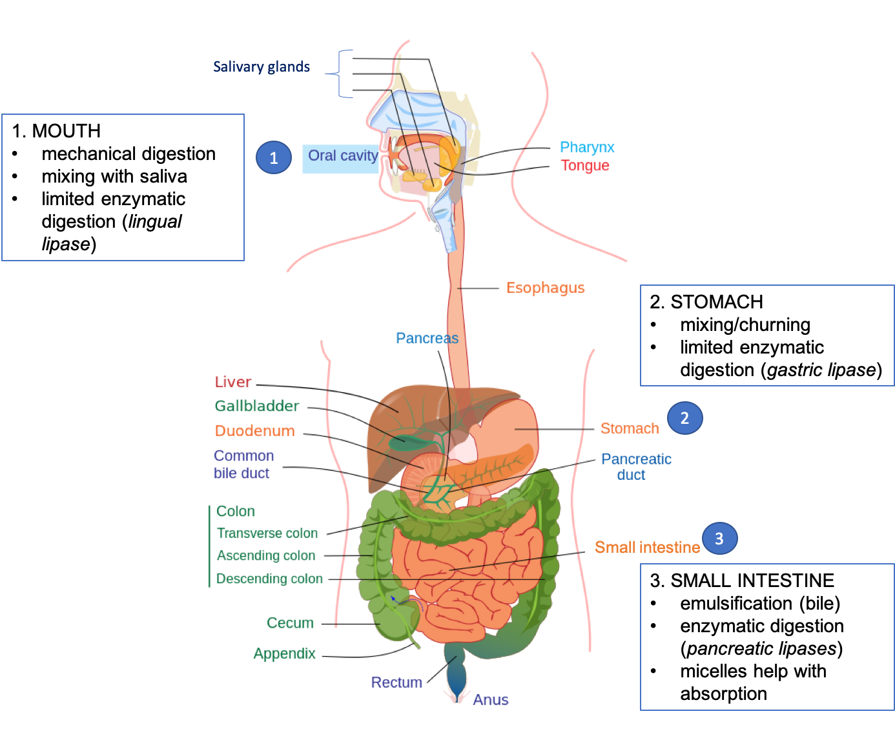

Slide 11
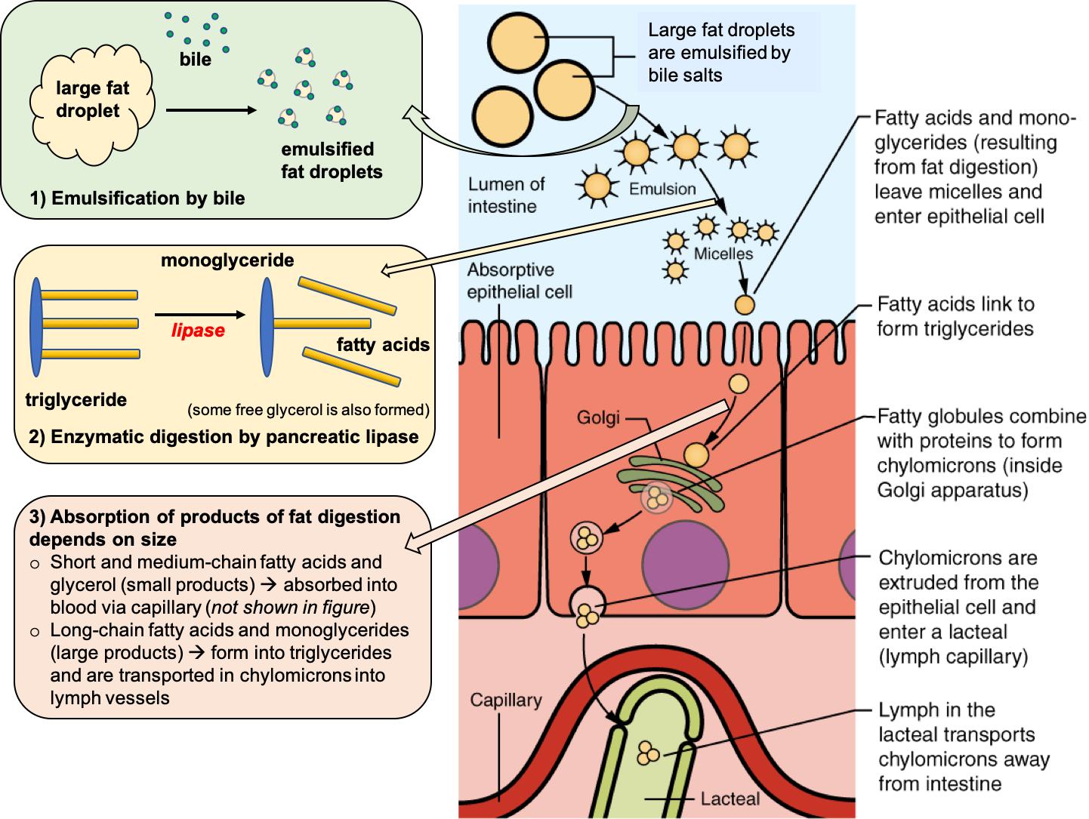

Slide 12
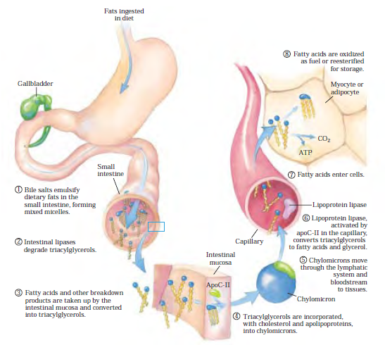
Processing of dietary lipids in vertebrates.

Slide 13
Processing of dietary lipids in vertebrates
In vertebrates, before ingested triacylglycerols can be absorbed through the intestinal wall
they must be converted from insoluble macroscopic fat particles to finely dispersed microscopic micelles.
This solubilization is carried out by bile salts, such as taurocholic acid
synthesized from cholesterol in the liver,stored in the gallbladder, and released into the small intestine after ingestion of a fatty meal.
Bile salts are amphipathic compounds that act as biological detergents,converting dietary fats into mixed micelles of bile salts and triacylglycerols

Slide 14
Nb Steps
1.Bile salts are amphipathic compounds that act as biological detergents,converting dietary fats into mixed micelles of bile salts and triacylglycerols
2. Micelle formation enormously increases the fraction of lipid molecules accessible to the action of water-soluble lipases in the intestine, and lipase action converts triacylglycerols to monoacylglycerols (monoglycerides) and diacylglycerols (diglycerides), free fatty acids, and glycerol
3. These products of lipase action diffuse into the epithelial cells lining the intestinal surface (the intestinal mucosa)
4. where they are reconverted to triacylglycerols and packaged with dietary cholesterol and specific proteins into lipoprotein aggregates called chylomicrons

Slide 15
5. The protein moieties of lipoproteins are recognized by receptors on cell surfaces. In lipid uptake from the
intestine, chylomicrons, which contain apolipoprotein C-II (apoC-II), move from the intestinal mucosa into the lymphatic system, and then enter the blood, which carries them to muscle and adipose tissue
6. In the capillaries of these tissues, the extracellular enzyme lipoprotein lipase, activated by apoC-II, hydrolyzes triacylglycerols to fatty acids and glycerol
7. which are taken up by cells in the target tissues
8. In muscle, the fatty acids are oxidized for energy in adipose tissue, they are reesterified for storage as triacylglycerols

Slide 16
The remnants of chylomicrons, depleted of most of their triacylglycerols but still containing cholesterol and apolipoproteins, travel in the blood to the liver, where they are taken up by endocytosis, mediated by receptors for their apolipoproteins.
Triacylglycerols that enter the liver by this route may be oxidized to provide energy or to provide precursors for the synthesis of ketone bodies
When the diet contains more fatty acids than are needed immediately for fuel or as precursors, the liver converts them to triacylglycerols, which are packaged with specific apolipoproteins into VLDLs.
The VLDLs are transported in the blood to adipose tissues, where the triacylglycerols are removed and stored in lipid droplets within adipocytes.

Slide 17
Digestion in the Mouth
Chewing mechanically breaks food into smaller particles and mixes them with saliva.
An enzyme called lingual lipase is produced by cells on the tongue (Ebner’s gland)
Optimum PH value of lingual lipase is 4.0 to 4.5
Lingual lipase is more active on TG having shorter FA chains and is found to be more specific for ester linkage at 3-position rather than position-1.
Milk fat appears to be the best substrate for this enzyme
The released short chain fatty acids are relatively more soluble and hydrophilic and can be absorbed directly from the stomach wall and enter the portal vein.

Slide 18
Digestion in the Stomach
In the stomach, mixing and churning helps to disperse food particles and fat molecules.
Cells in the stomach produce another lipase, called gastric lipase
Lingual lipase swallowed with food and saliva also remains active in the stomach
In the stomach, gastric lipase starts to break down triglycerides into diglycerides and fatty acids.
Fats do play one important role in the stomach in that they delay the rate of emptying of stomach, presumably by way of the hormone enterogastrone, which inhibits gastric motility and retards the discharge of bolus of food from the stomach.
Thus fats have a high satiety value.

Slide 19
Digestion in the Small Intestine
As the stomach contents enter the small intestine, most of the dietary lipids are undigested and clustered in large droplets.
Bile, which is made in the liver and stored in the gallbladder, is released into the duodenum, the first section of the small intestine.
Bile contains bile salts (sodium glycocholate and sodium taurocholate), lecithin, and substances derived from cholesterol so it acts as an emulsifier.
Bile salts have both a hydrophobic and a hydrophilic side, so they are attracted to both fats and water.
This makes them effective emulsifiers
Emulsification makes lipids more accessible to digestive enzymes by increasing the surface area for them to act ie surface tension is reduced. Bile salts, peristalsis and phospholipid enhance it.

Slide 20
Once the stomach contents have been emulsified, the pancreas secretes pancreatic lipases into the small intestine to enzymatically digest triglycerides.
Pancreatic lipase is virtually specific for the hydrolysis of “primary ester linkage”.
It cannot readily hydrolyse the ester linkage of position-2 (β), if it does so it occurs at a very slow rate.
Digestion of TG molecule by pancreatic lipase proceeds by;
removal of a terminal FA to produce an α-diglyceride
The other terminal FA is then removed to produce a β-monoglyceride.
The β-monoglyceride is first converted to α -monoglyceride by isomerisation by an “isomerase” enzyme.
Then the α-monoglyceride is hydrolysed by pancreatic lipase.

Slide 21
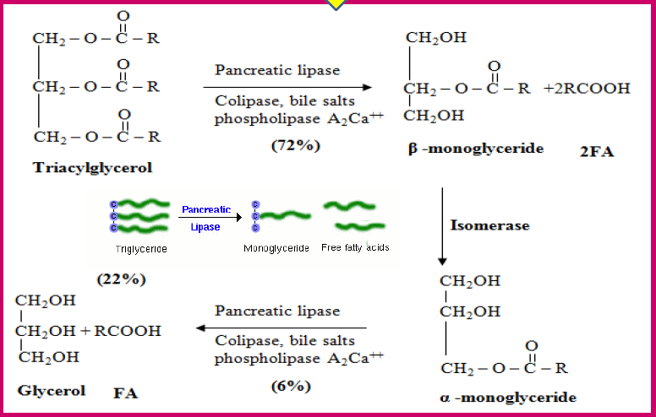

Slide 22
Just as lipids require special handling in the digestive tract to move within a water-based environment, they require similar handling to travel in the bloodstream.
The fatty acids of short and medium chain length( < 10 carbons), after their absorption into the intestinal cells, do not undergo any modification.
They enter the portal circulation and are transported to the liver in a bound form to albumin.

Slide 23
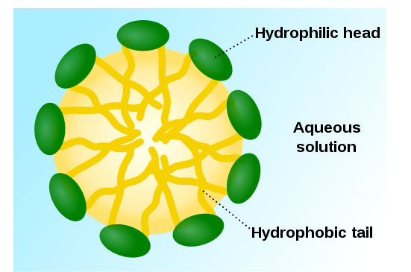
Lipids Absorption from the small Intestine
How will the fats pass through the watery layer of mucus that coats the absorptive lining of the digestive tract?
As before, the answer is bile. Bile salts envelop the fatty acids and monoglycerides to form micelles.
It help the fats get close enough to the microvilli of intestinal cells so that they can be absorbed.
The products of fat digestion diffuse across the membrane of the intestinal cells, and bile salts are recycled back to do more work emulsifying fat and forming micelles (enterohepatic circulation of bile)

Slide 24
Inside the intestinal cells, the monoglycerides and fatty acids reassemble themselves into triglycerides.
The long chain fatty acids are activated by thiokinase (fatty acyl CoA synthetase) in the intestinal cells.
The acyl CoA derivatives so formed combine with 2-monoacylglycerols to produce triacylglycerols.
These reactions are catalysed by a group of enzymes, namely acyltransferase

Slide 25
Lipids Transport
The interior of a lipoprotein—called the lipid core—carries the triglycerides and cholesterol esters, both of which are insoluble in water.
The exterior of lipoproteins—called the surface coat—is made up of components that are at least partially soluble in water: proteins (called apolipoproteins), phospholipids, and unesterified cholesterol.
Together they form a chylomicron, which is a large lipoprotein that now enters the lymphatic system and will soon be released into the bloodstream
The phospholipids are oriented so that their water-soluble heads are pointed to the exterior, and their fat-soluble tails are pointed towards the interior of the lipoprotein.
Apoliproteins are similarly amphipathic (soluble in both fat and water), a property that makes them useful for aiding in the transport of lipids in the blood.

Slide 26
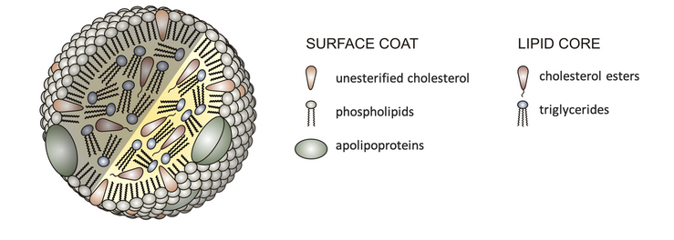
Basic Structure of Lipoprotein

Slide 27
Chylomicrons Deliver Lipids to Cells for Utilization and Storage
The job of chylomicrons is to deliver triglycerides (originating from digested food) to the cells of the body, where they can be used as an energy source or stored in adipose tissue for future use.
An enzyme called lipoprotein lipase sits on the surface of cells that line the blood vessels.
It breaks down triglycerides into fatty acids and glycerol, which can then enter nearby cells.
If those cells need energy right away, they’ll oxidize the fatty acids to generate ATP. If they don’t need energy right away, they’ll reassemble the fatty acids and glycerol into triglycerides and store them for later use.
As triglycerides are removed from the chylomicrons, they become smaller. These chylomicron remnants travel to the liver, where they’re disassembled.

Slide 28
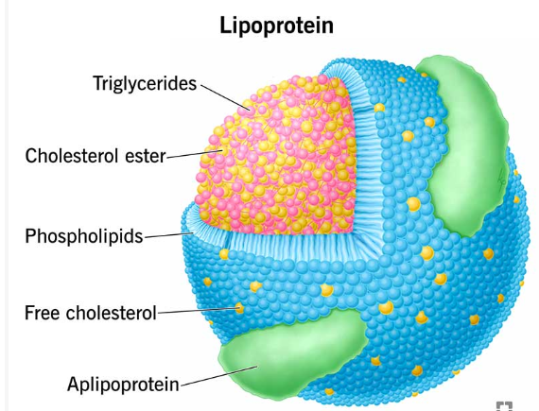
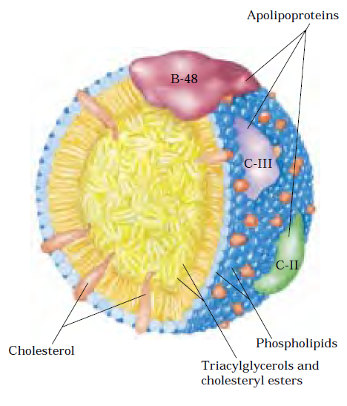
Chylomicron
Notes:
Chylomicrons
The surface is a layer of phospholipids, with head groups facing the aqueous phase.
Triacylglycerols sequestered in the interior (yellow) make up more than 80% of the mass.
Several apolipoproteins that protrude from the surface (B-48, C-III, C-II) act as signals in the uptake and metabolism of chylomicron contents. The diameter of chylomicrons ranges from about 100 to 500 nm.

Slide 29
Lipid Transport from the Liver
The contents of chylomicron remnants, as well as other lipids in the liver, are incorporated into another type of lipoprotein called very-low-density lipoprotein (VLDL).
The main job of VLDL is delivering triglycerides to the body’s cells, and lipoprotein lipase again helps to break down the triglycerides so that they can enter cells
As triglycerides are removed from VLDL, they get smaller and more dense, because they now contain relatively more protein compared to triglycerides.
They become intermediate-density lipoproteins (IDL) and eventually low-density lipoproteins (LDL).
The main job of LDL is to deliver cholesterol to the body’s cells.

Slide 30
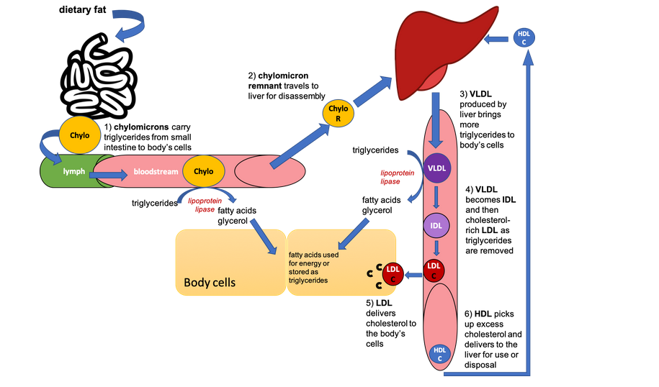
High-density lipoproteins (HDL) are made in the liver and gastrointestinal tract. They’re mostly made up of protein, so they’re very dense. Their job is to pick up cholesterol from the body’s cells and return it to the liver for disposal.

Slide 31
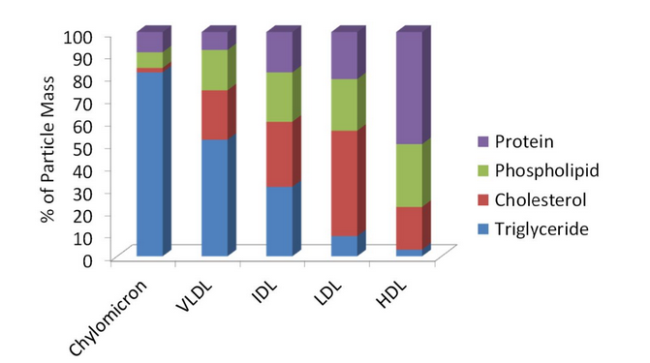
Comparison of composition of lipoproteins

Slide 32
Lipid profile in human
Lipid Fractions | Reference value (mg/dl)
Total lipid | 400-600
Total Cholesterol | 150-200
LDL Cholesterol | 80-150
HDL | 30-60
VLDL | 20-40
TAG | 70-150
Phospholipids | 150-200
Free fatty acids | 5-15

